Slide 1

MAD Contest 2017
Dean Schulz

Slide 2
Class Time
App name: Class Time
Developed using Android Studio
Directed towards use of students
User friendly and efficient
One of a kind
Deals with 2 main problems

Slide 3
Problems
Late for a class or event
Ringtone goes off during class

Slide 4
Features
Reminds you a given amount of time before a class to start heading over
Mutes phone or sets to vibrate during classes
Displays which class is next
Easy access to your class schedule in one organized space
One time reminders (tests)
Can be used for any type of events
Usable with Android phones SDK version 16 to 25(latest)

Slide 5
Implementations
Realm – enables you to code the model layers of your app in safe and efficient way
Recyclerview and cardview – dynamic and modern way of making lists of buttons
MVC (model view controller) – Keeps code organized
Grantland Autofit
Haptic feedback

Slide 6
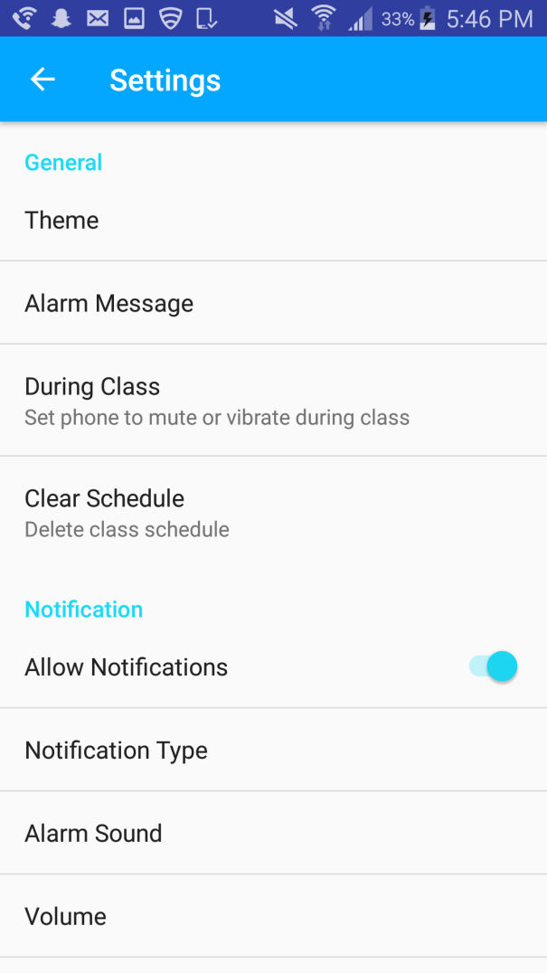
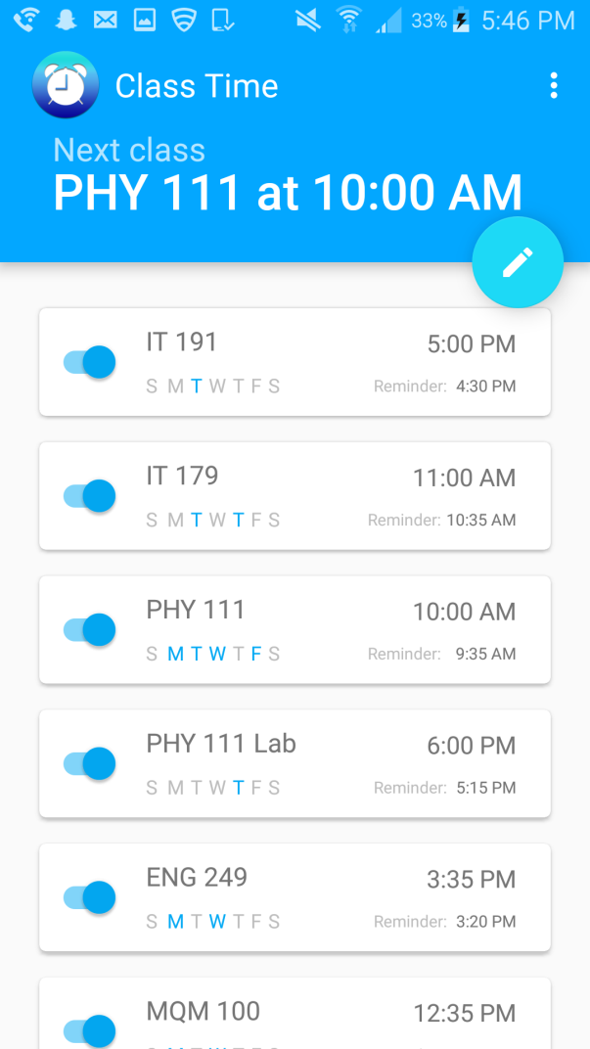
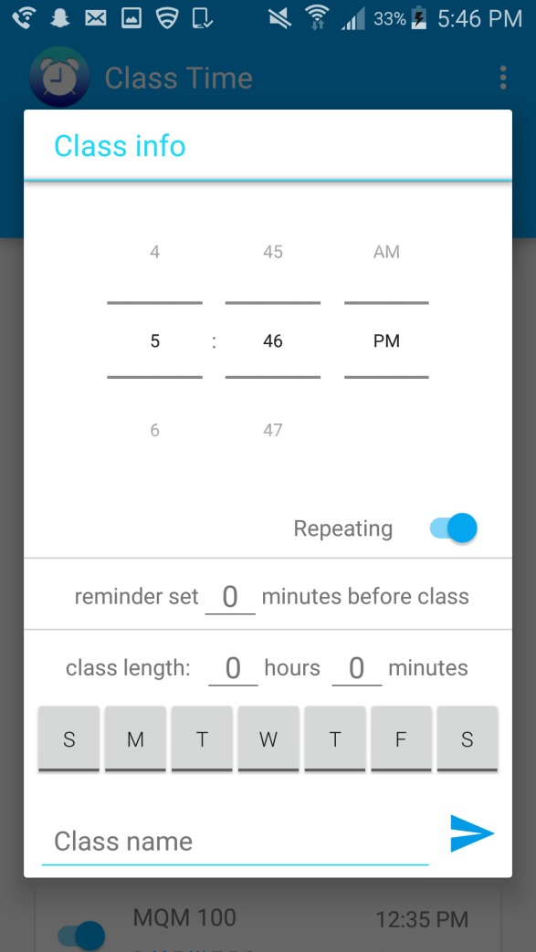
Navigation
Adding or updating a class
Settings
Main page

Slide 7
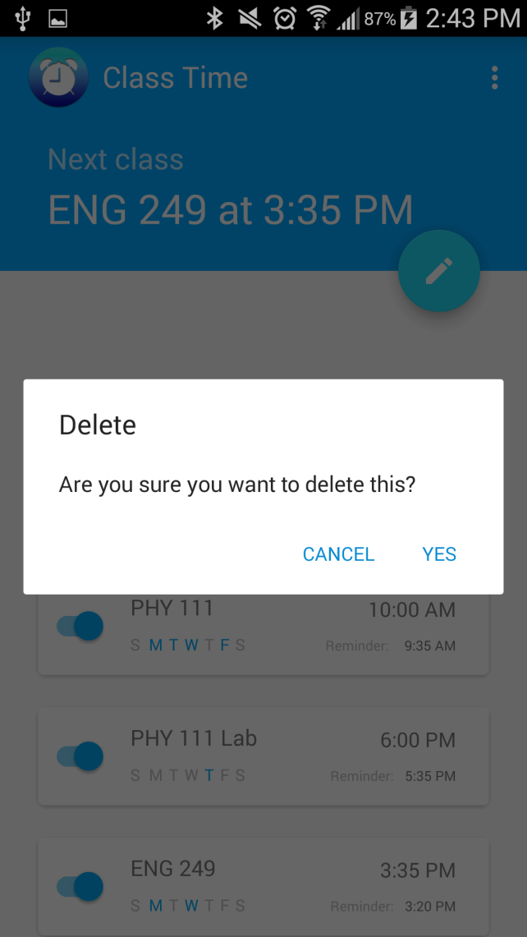
Main Screen
Swipe to delete

Slide 8
Adding a class

Slide 9
Settings menu

Slide 10
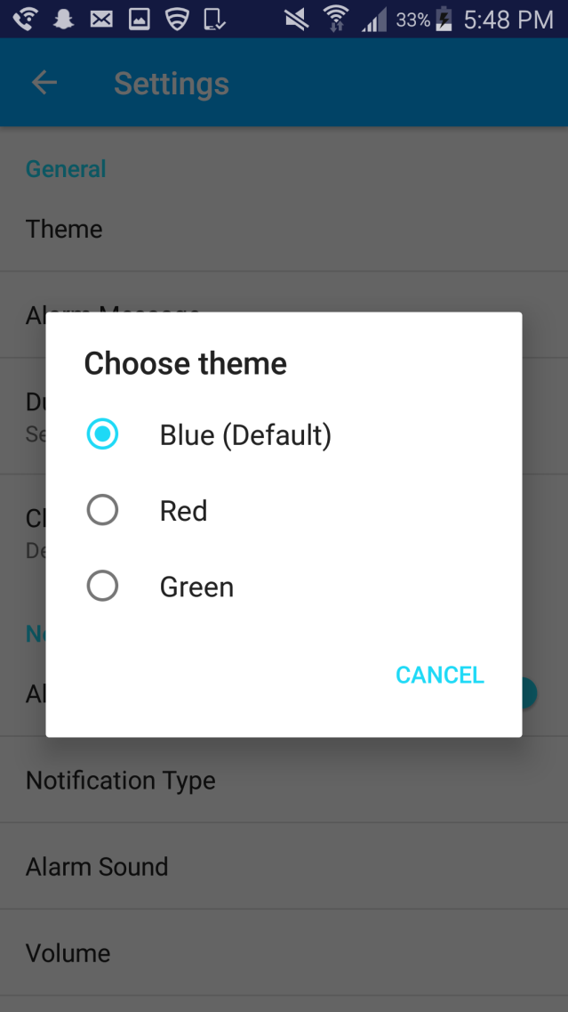
Theme

Slide 11
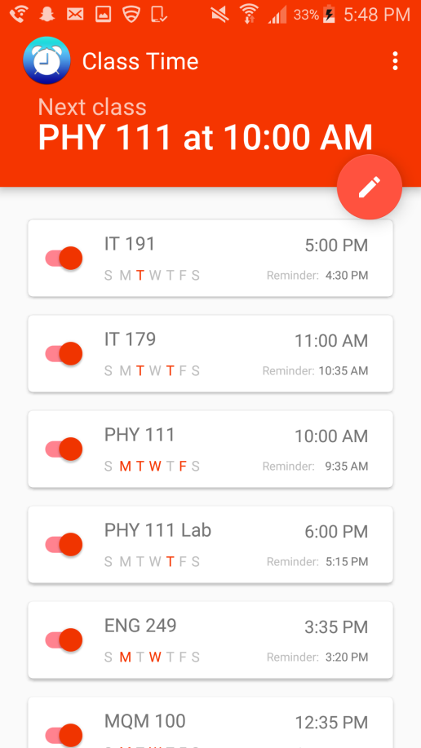
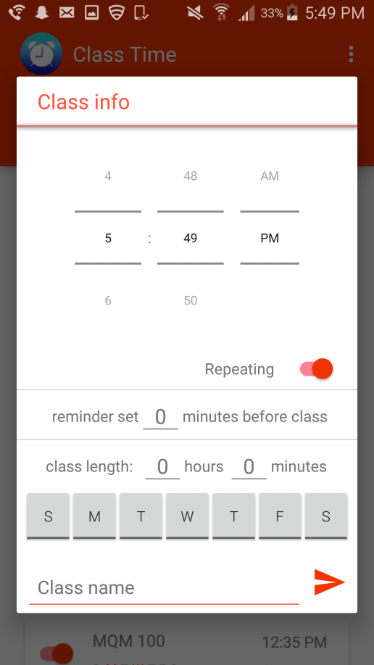
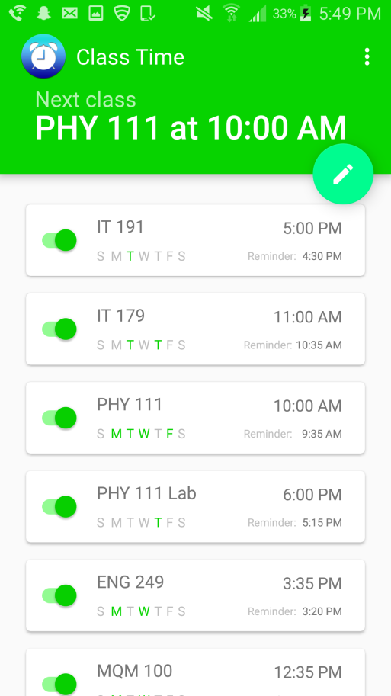
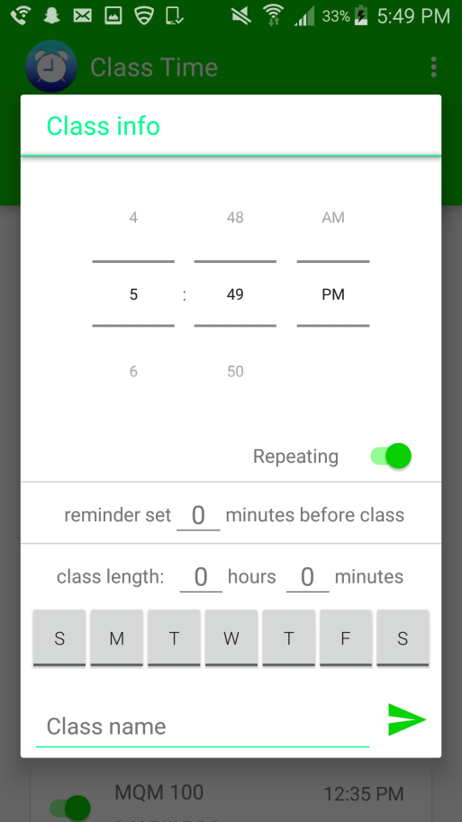
Themes

Slide 12
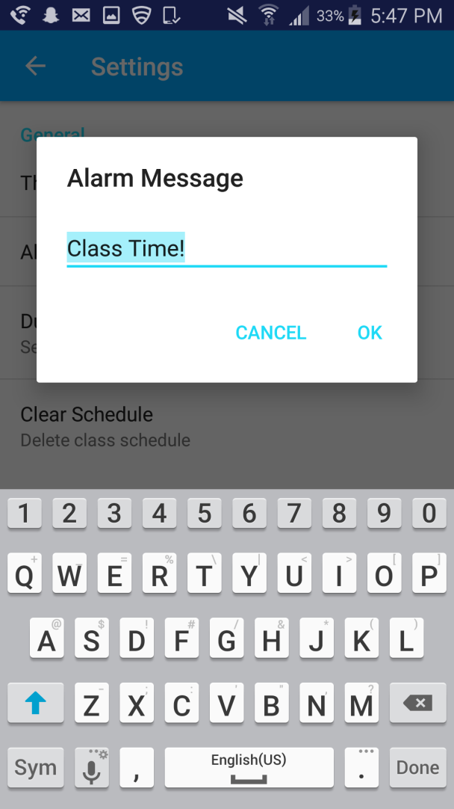
Alarm message

Slide 13
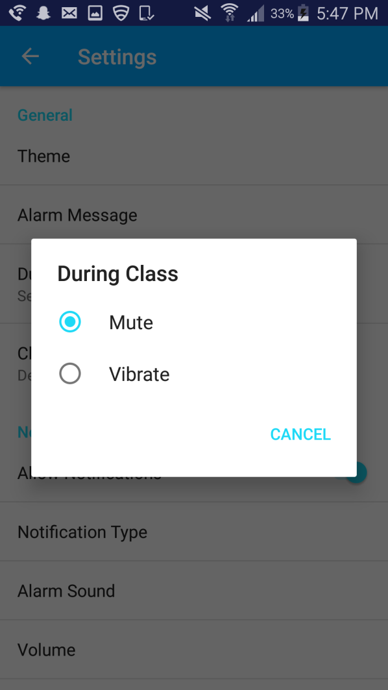
During class

Slide 14
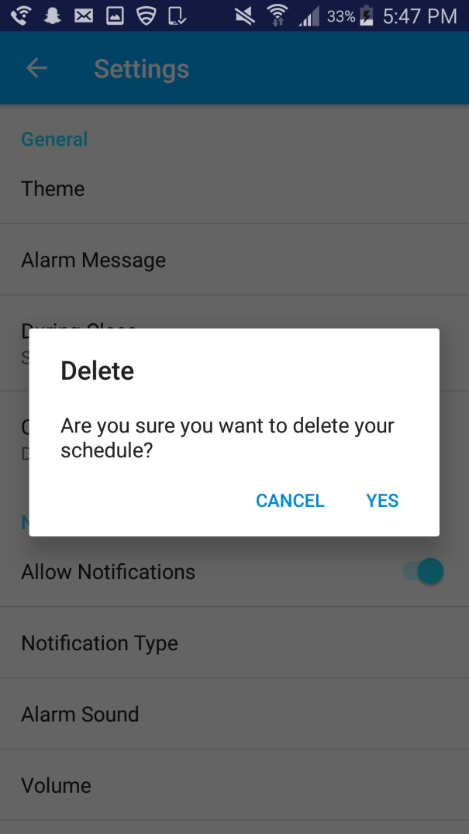
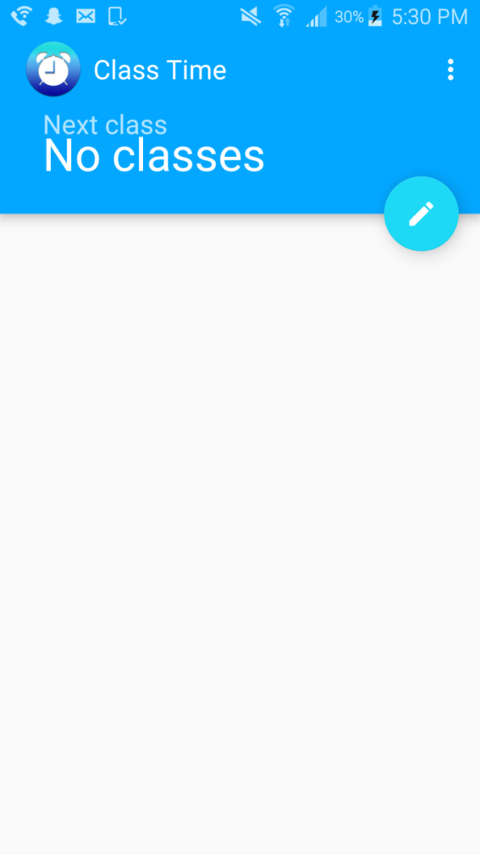
Clear schedule

Slide 15
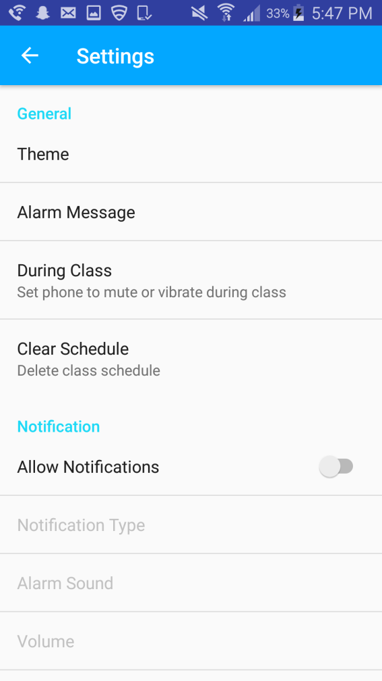
Allow notifications

Slide 16
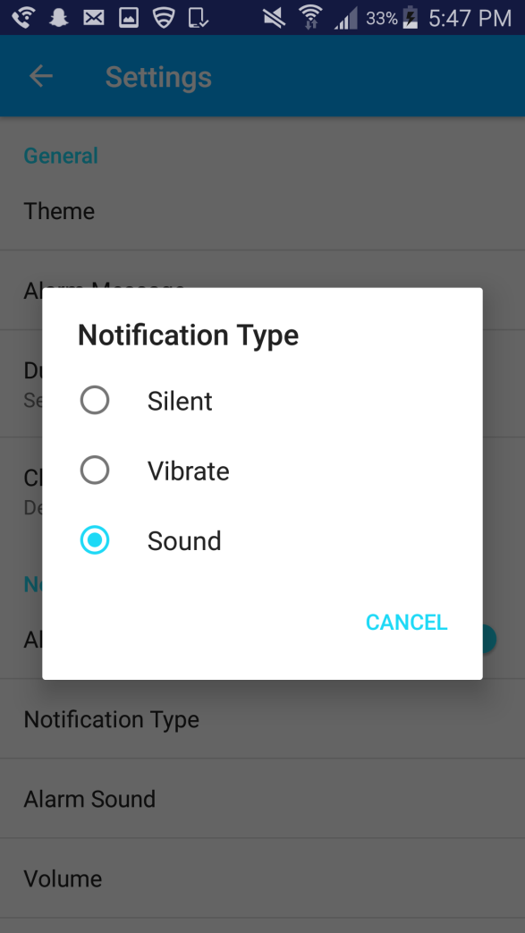
Notification type

Slide 17
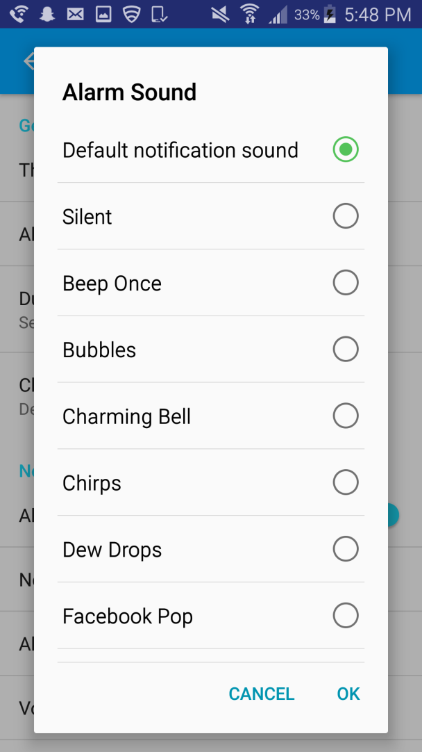
Alarm sound

Slide 18
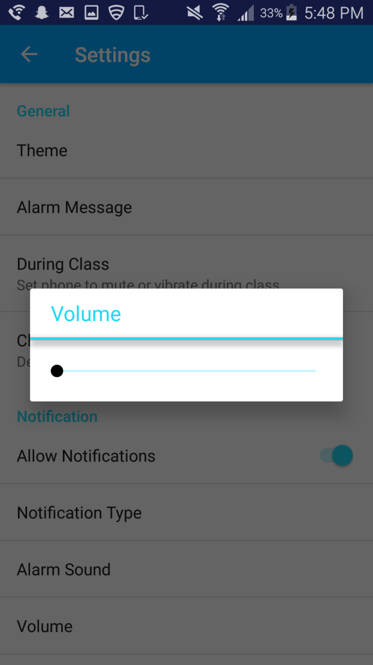
Volume

Slide 19
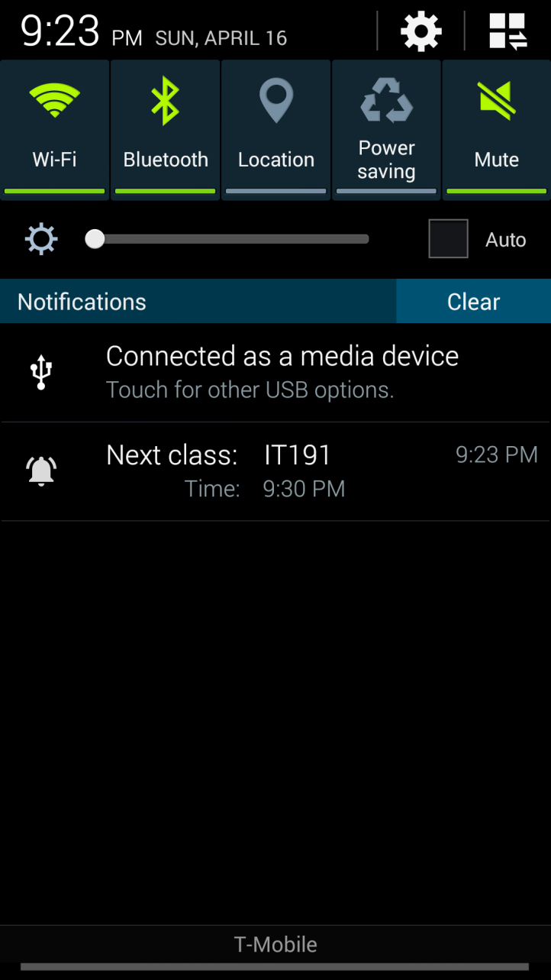
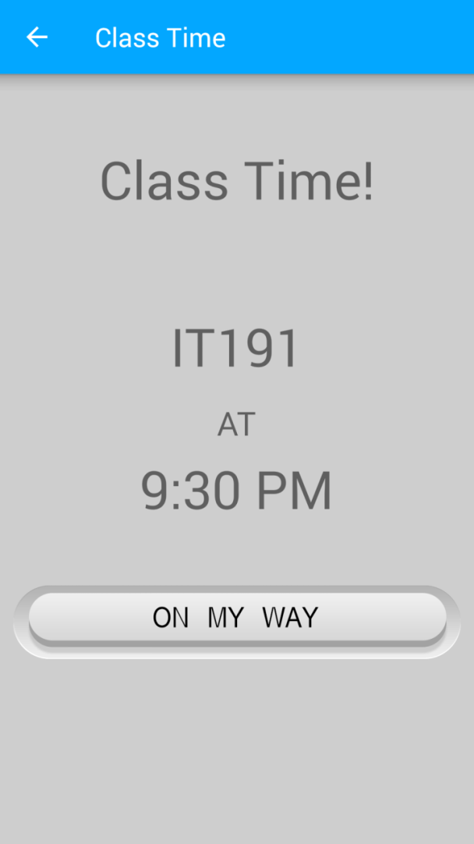
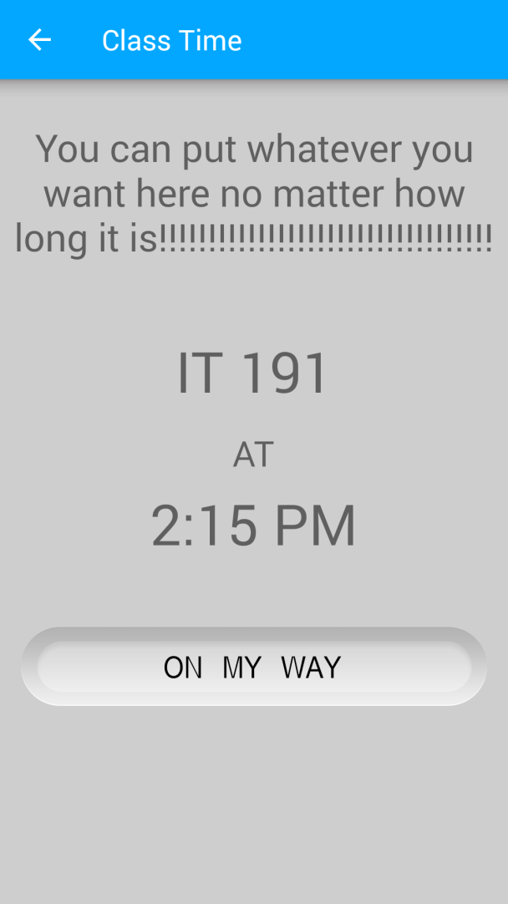
Notifications

Slide 20
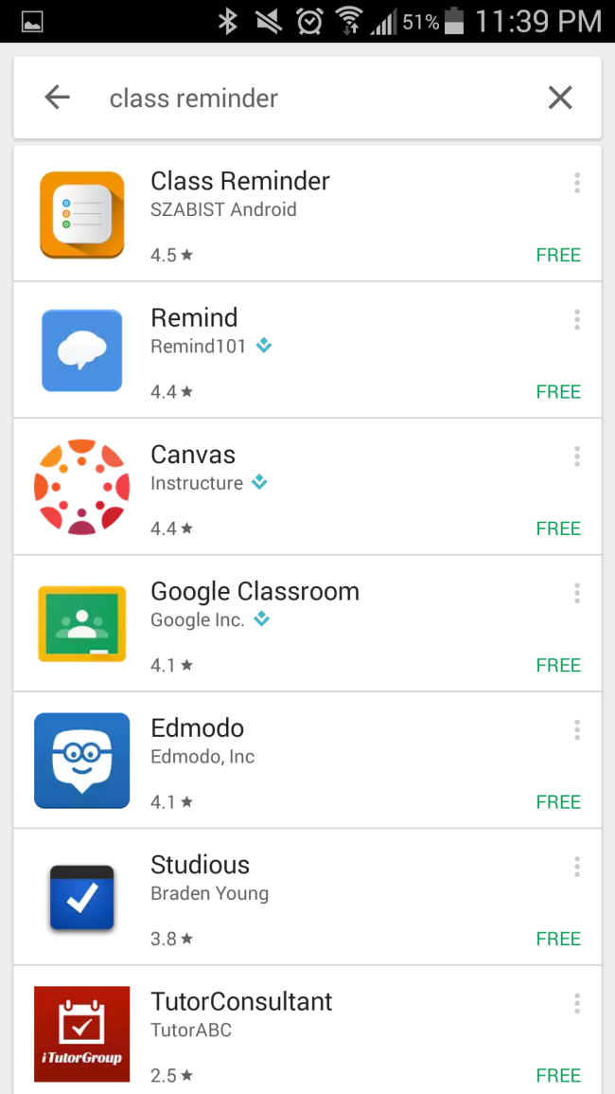
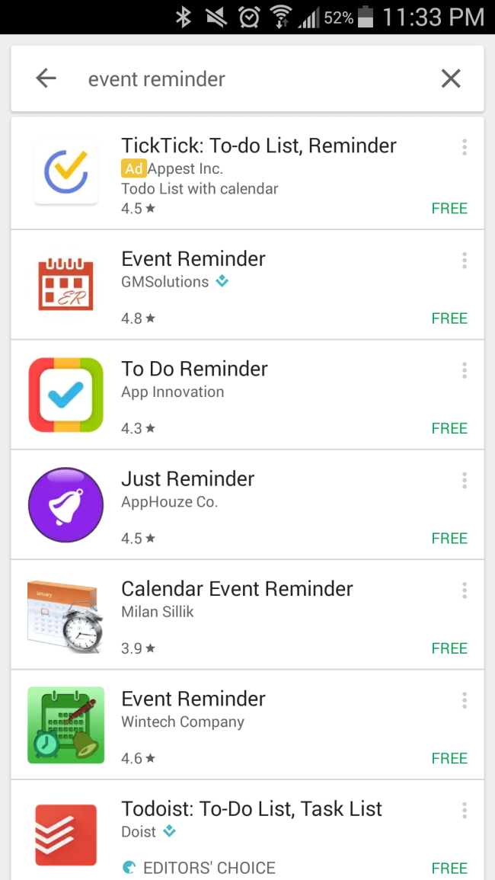
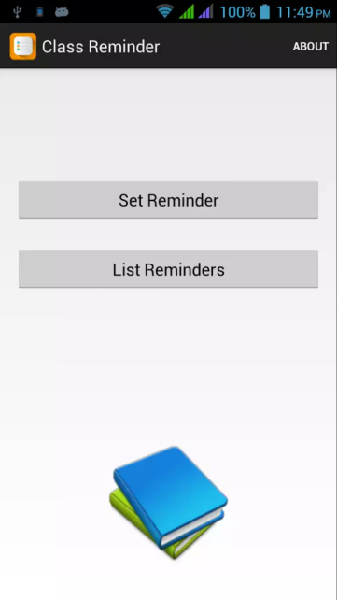
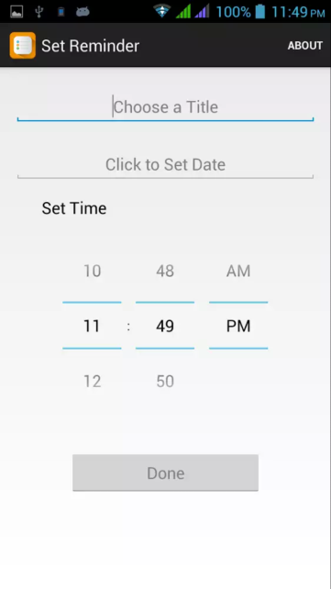
Others

Slide 21
Future plans
Add a dark theme
Smart watch capability
Release on IOS

Slide 22

Class Time Never be late again
https://www.sas.com/content/dam/SAS/en_us/image/sas-com/backgrounds/environments/Backgrounds_84A1364.jpg

